Slide 1


Slide 2
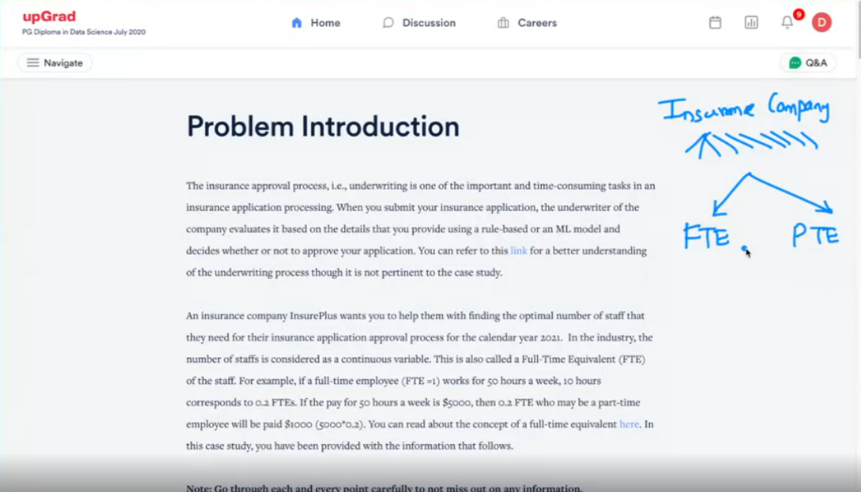

Slide 3
Problem statement
Its an insurance company that receives lots of claims
For approval and removal process to be smooth it distributes among 2 things;
One are there Full Time Employees(FTE)
Part Time Employees(PTE)
Main problem statement is how should the distribution of FTE vs. PTE so that the maximum utilization of FTE can be done followed by the PTE in such a way that FTE are given maximum amount of work and if the work cannot be done by FTE then we will get it done by outside person

Slide 4
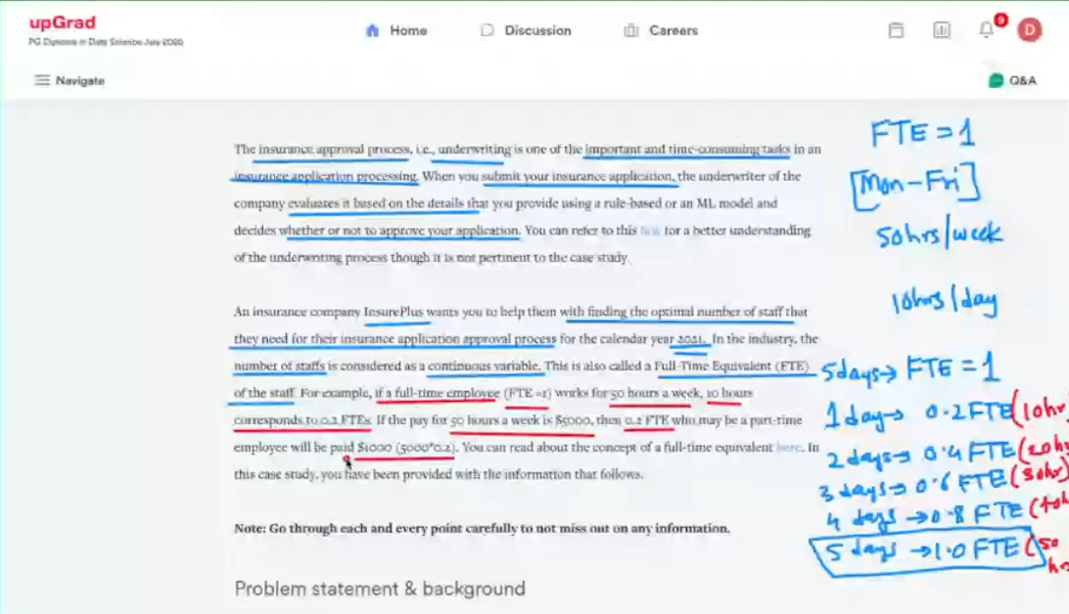

Slide 5
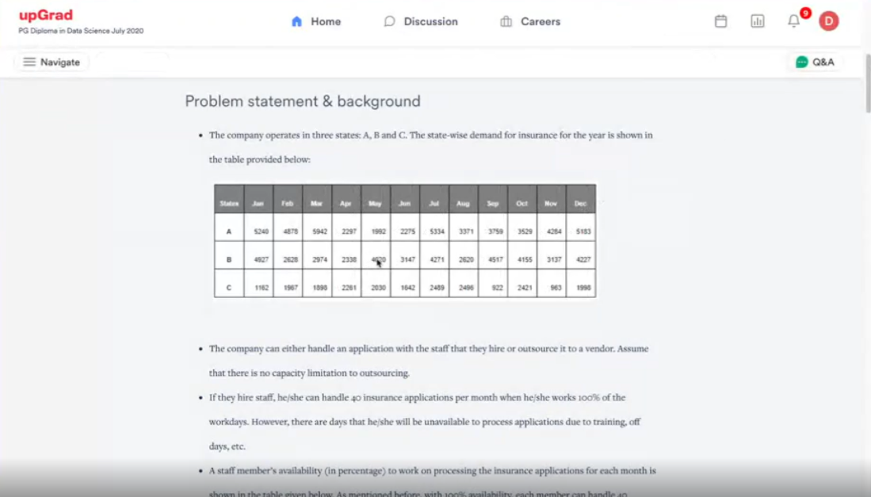

Slide 6
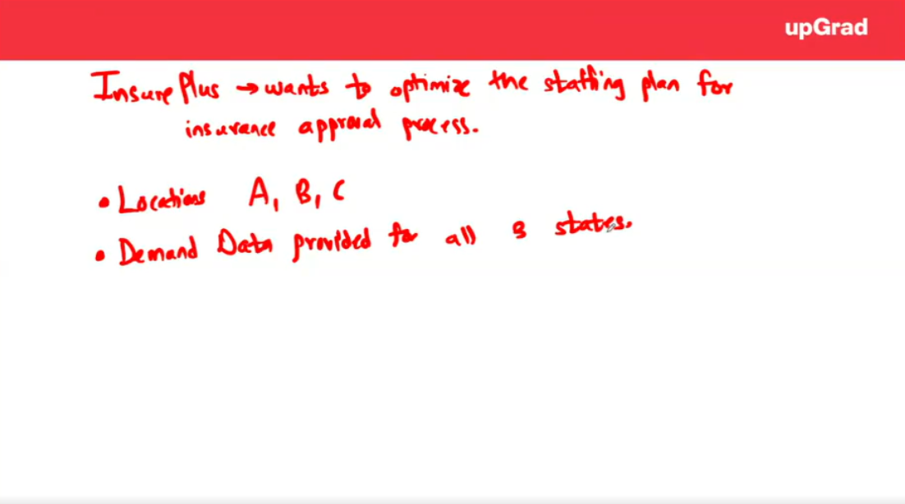

Slide 7
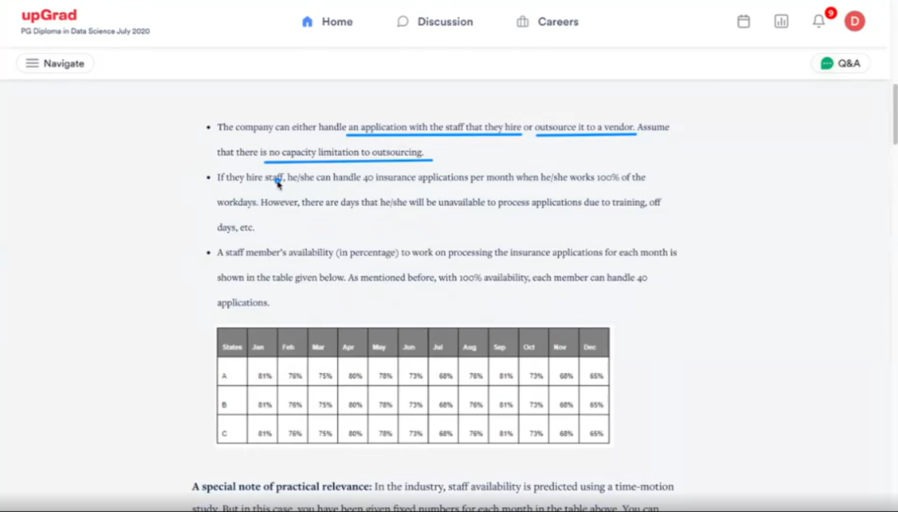

Slide 8
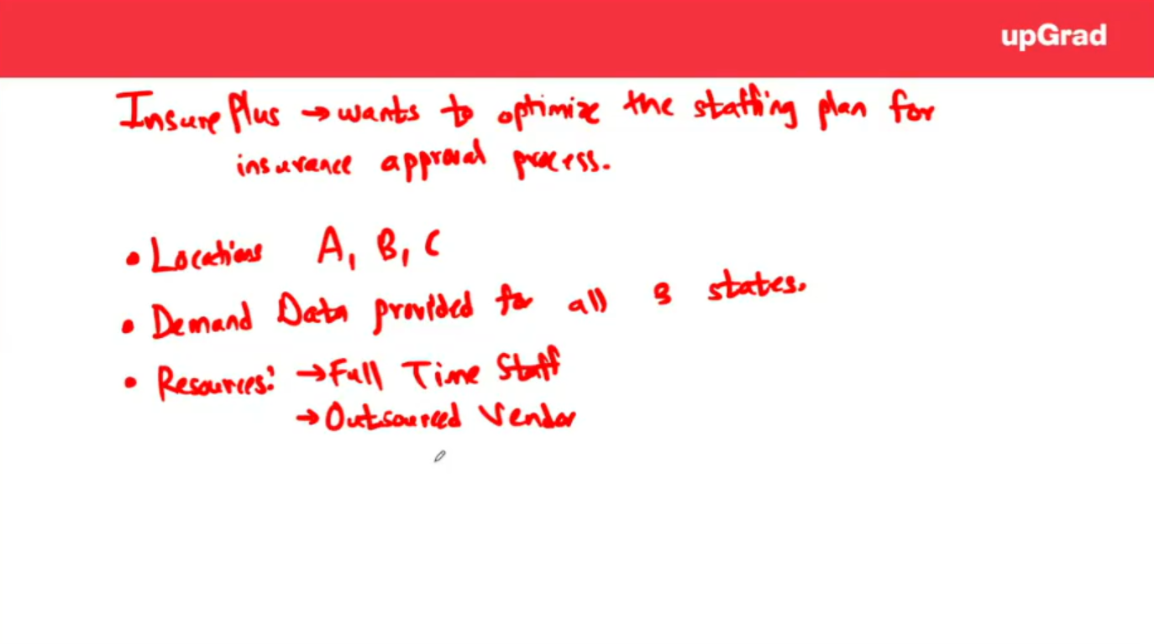

Slide 9
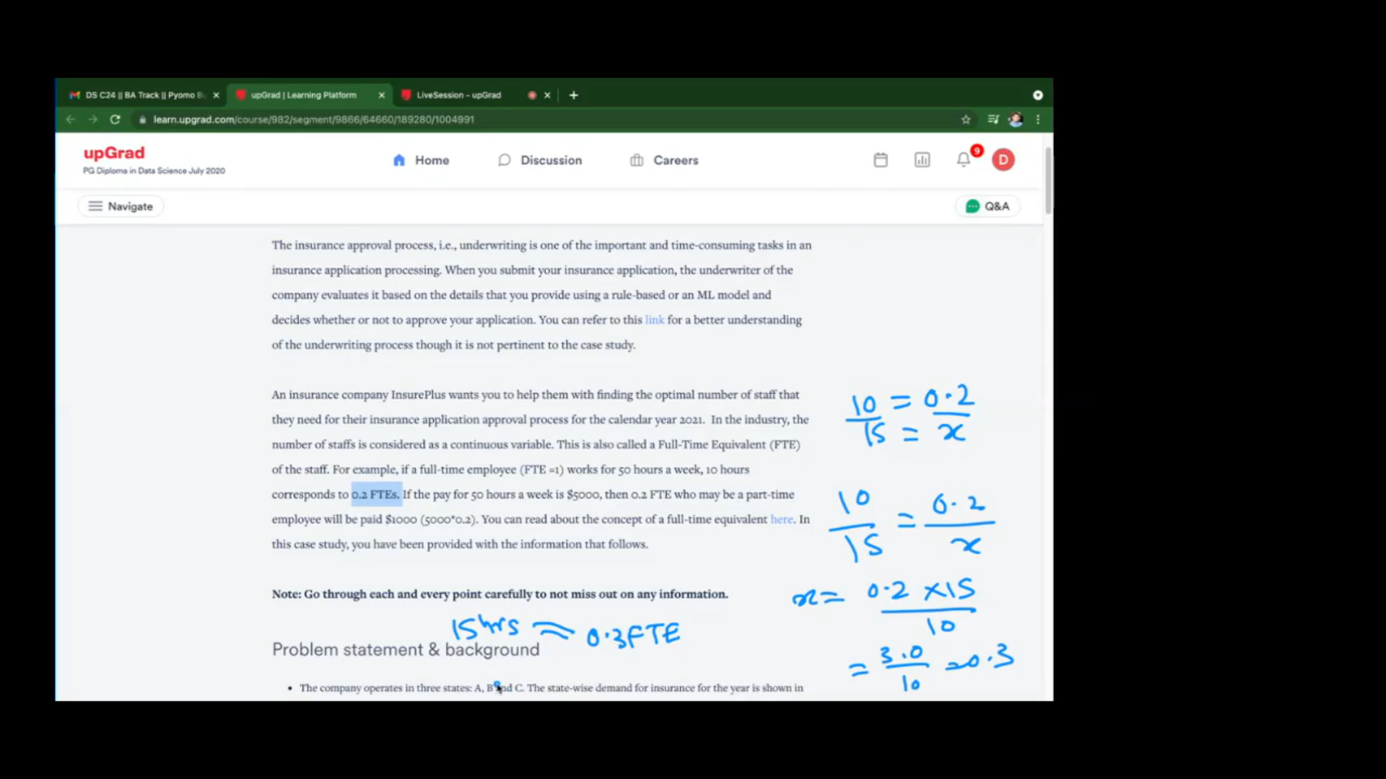
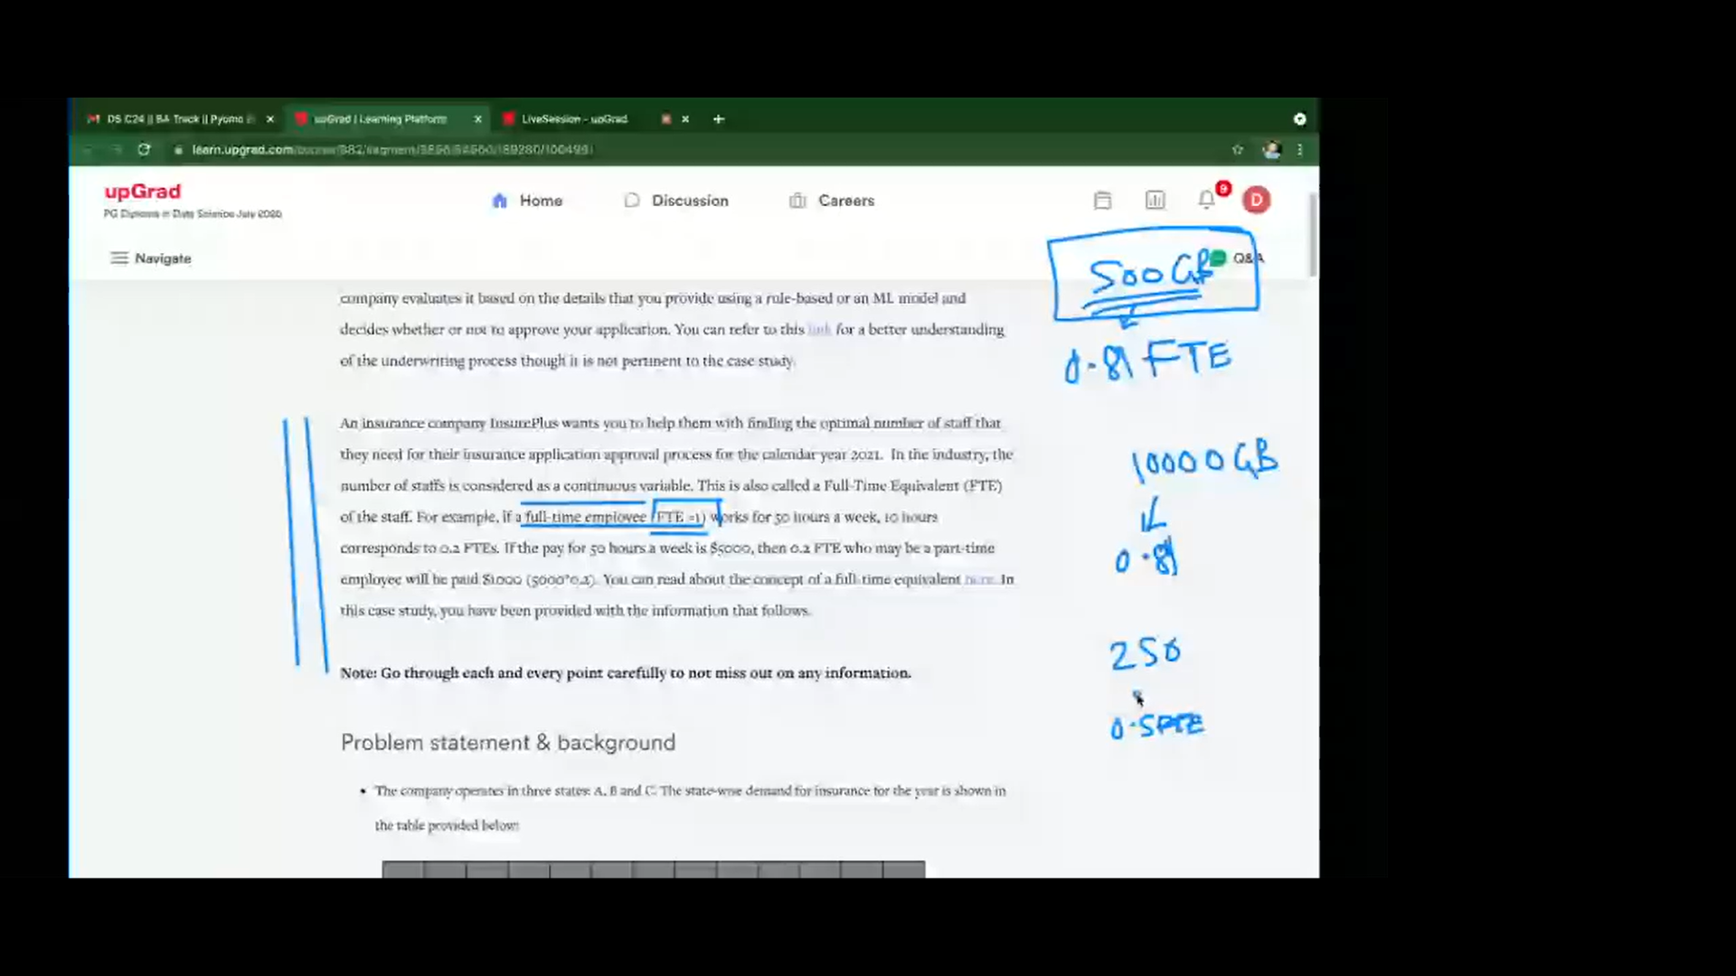
Notes:
FTE (Full Time Equivalent or Full Time Employees) – It is how many hours you are available for the company over the month. In the table we have overall availability of all the people working in the office in that month

Slide 10
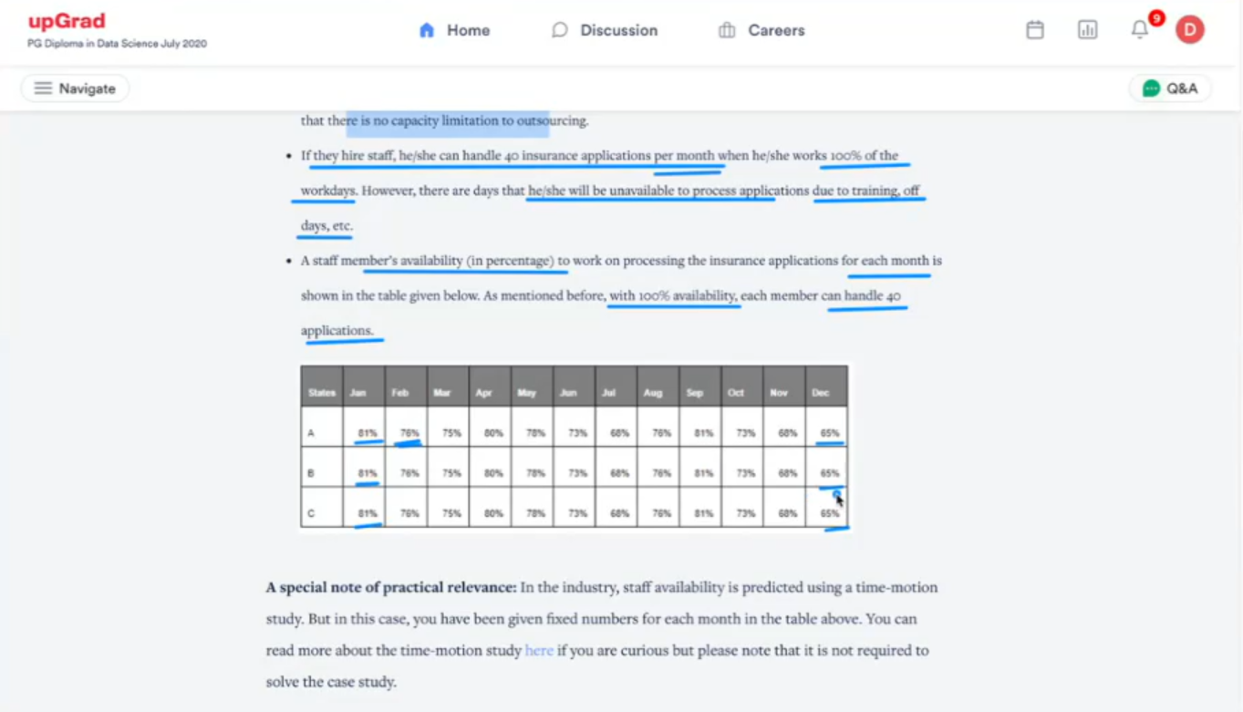

Slide 11
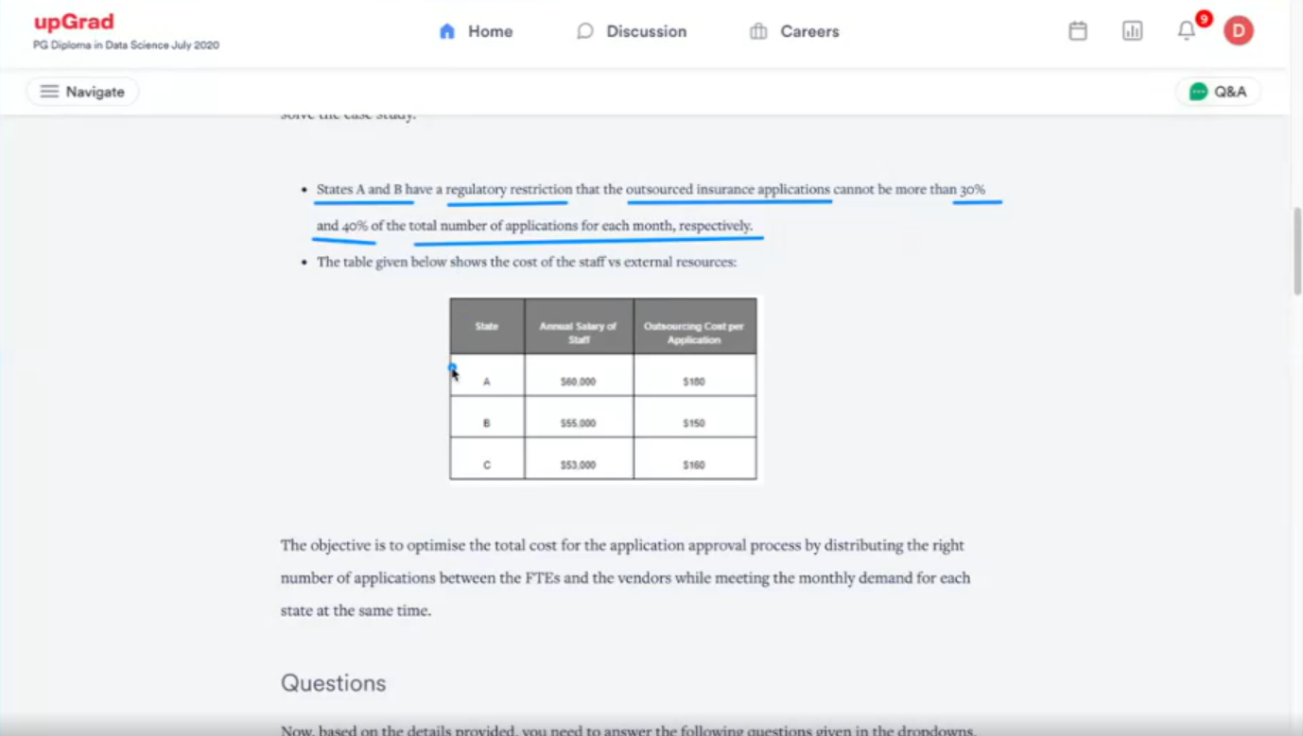
Constraints that we need to code

Slide 12
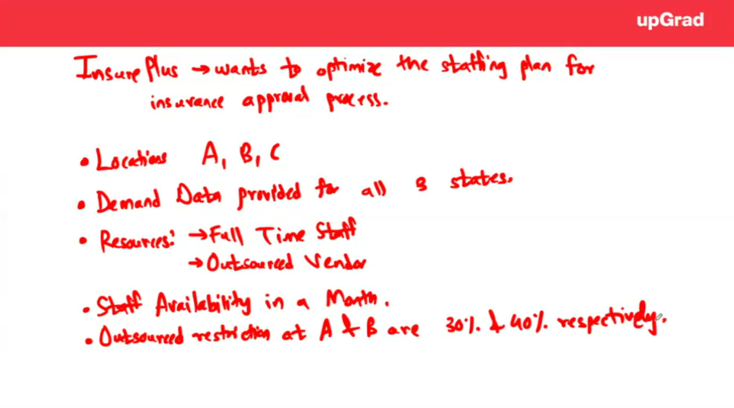

Slide 13
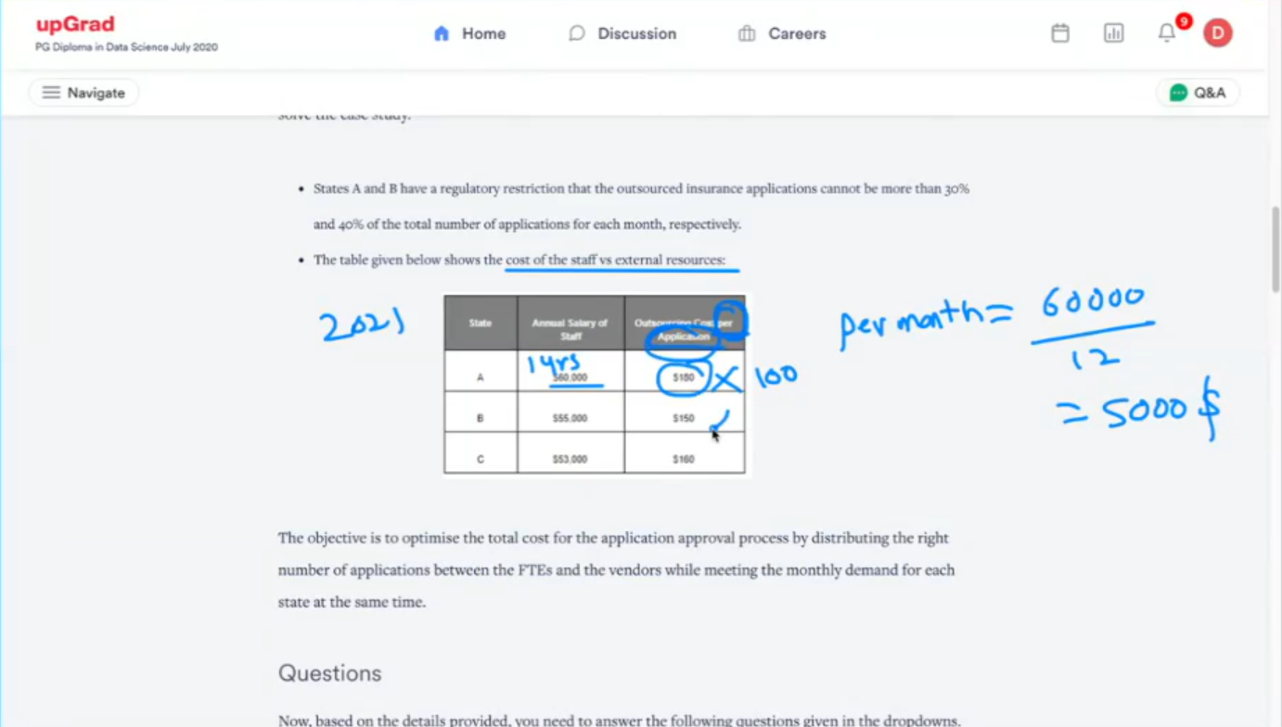

Slide 14
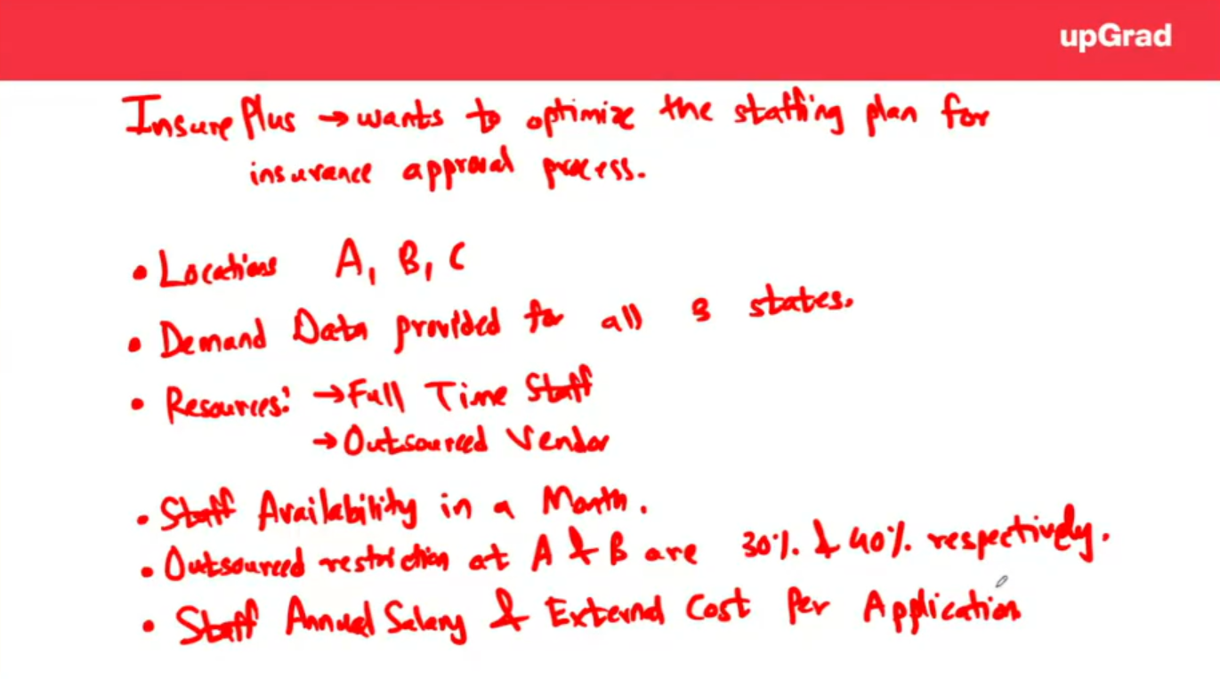

Slide 15
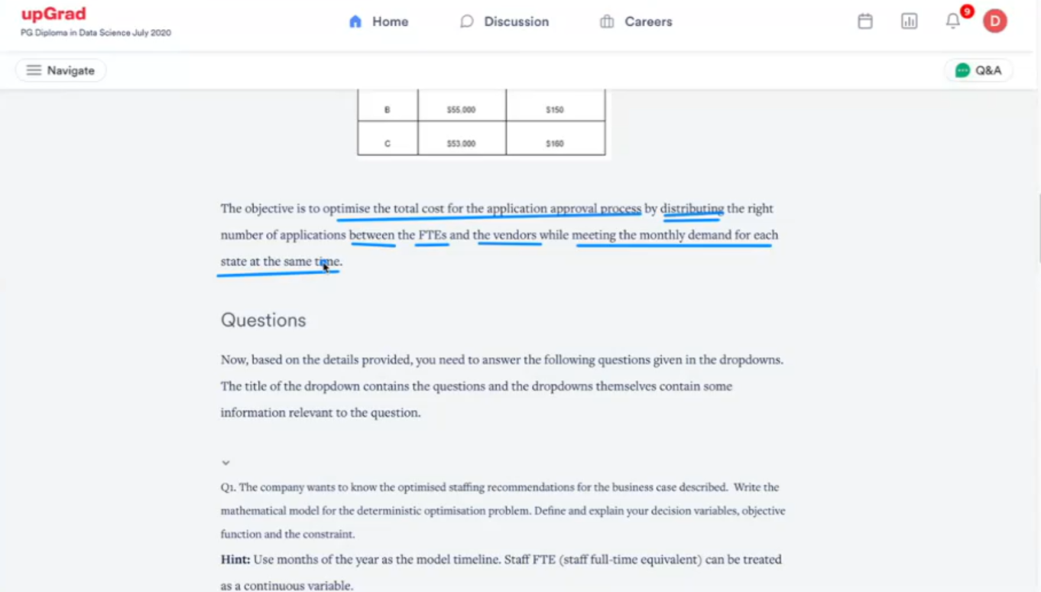

Slide 16
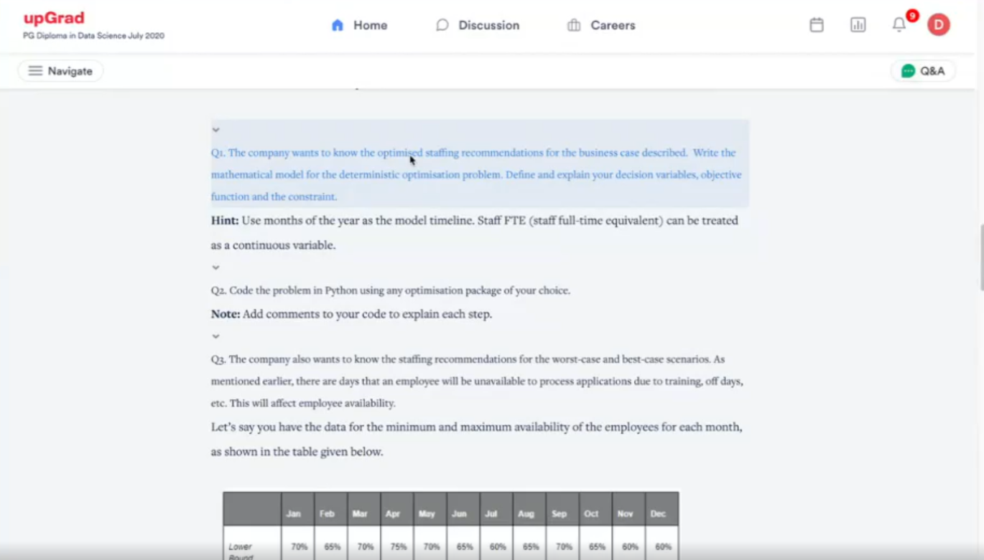
For that we have to write the mathematical model for deterministic optimization thing

Slide 17
Before Parameters lets understand what are the things we are given
We are given demand
We are given staff availability
We are given FTE salary per month

Slide 18
What are the things that we are given ?
We are given demand

Slide 19
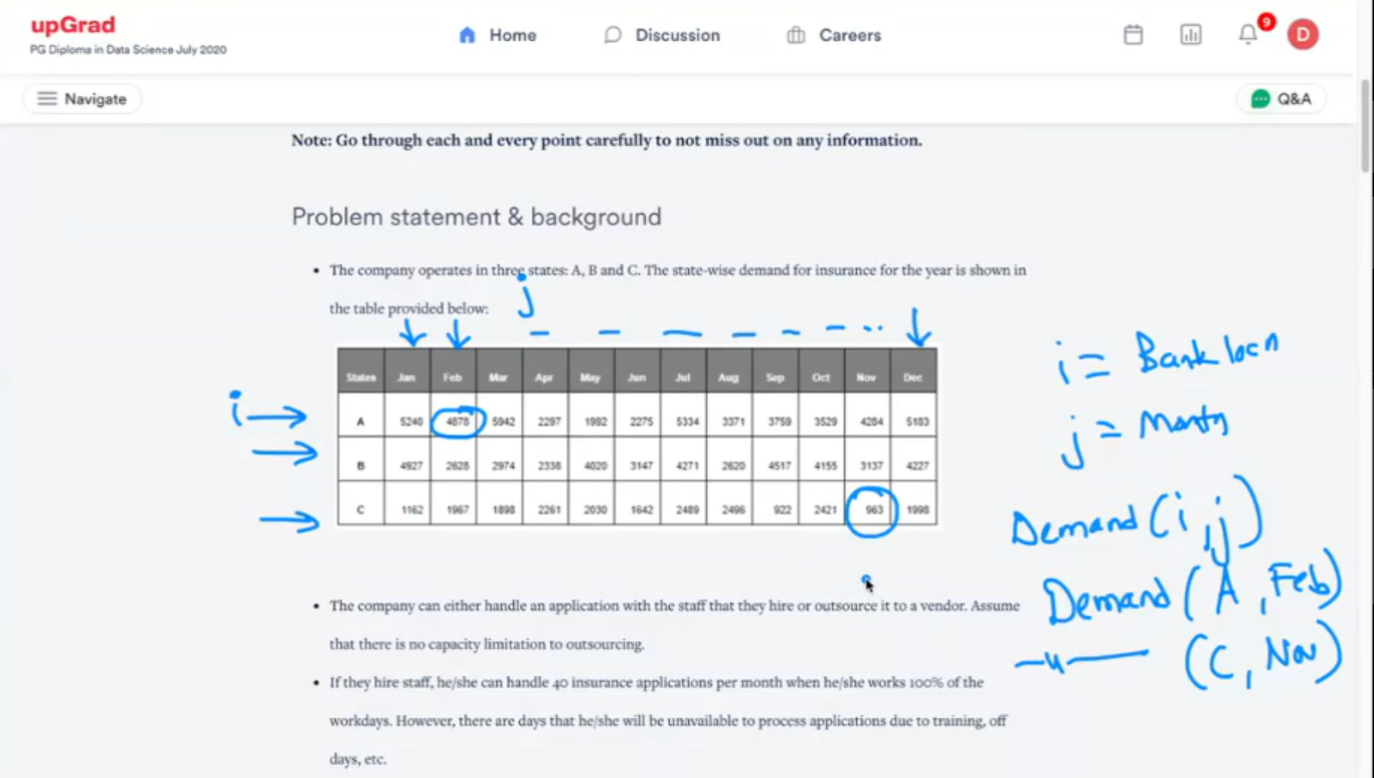
How do we find Demand ?

Slide 20
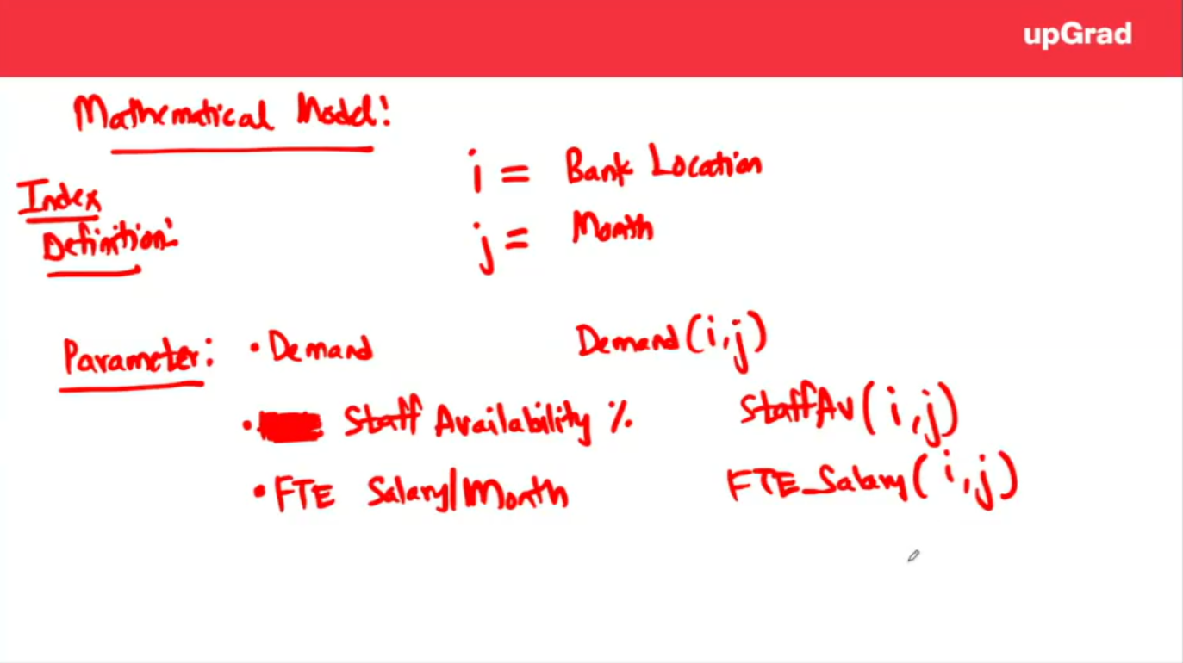
Notes:
How to formulating my model ?

Slide 21
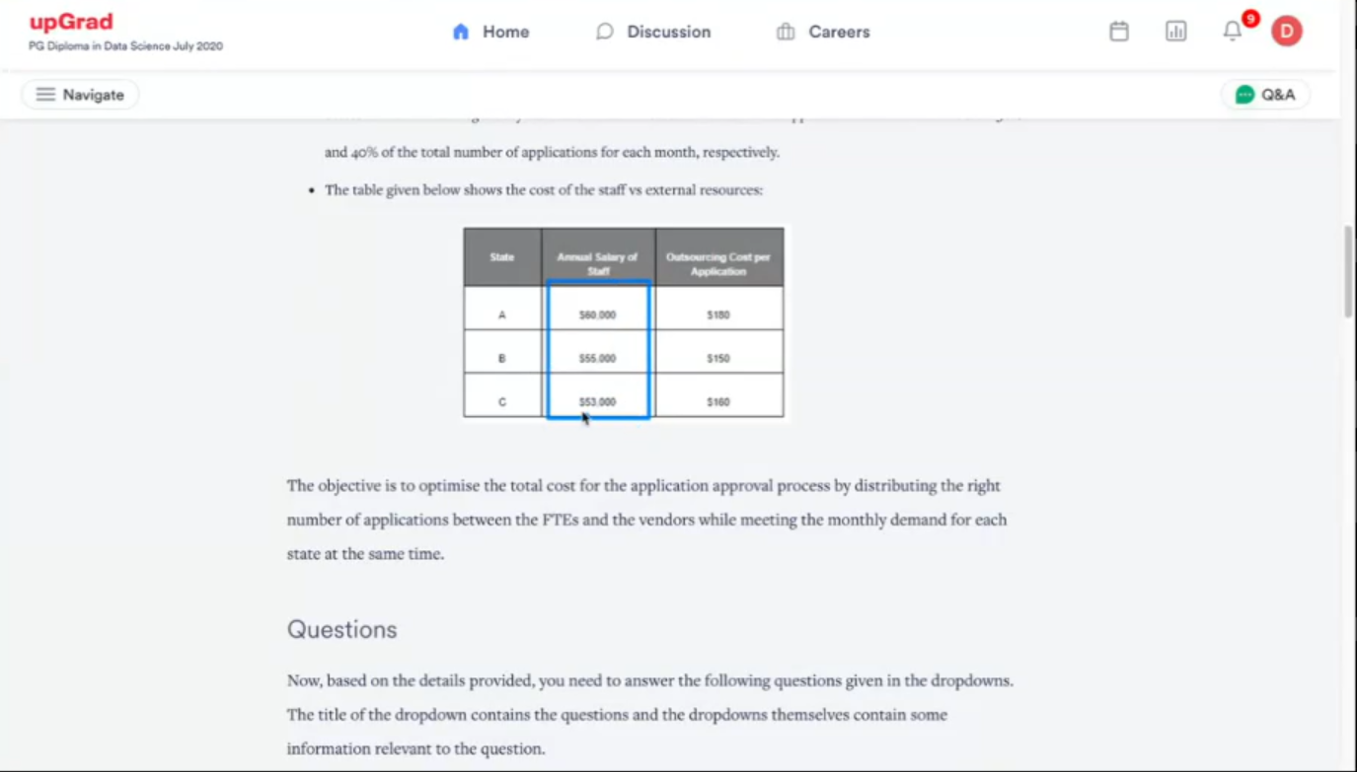
We understand the salary of i, j, where we undesrand bank location and j is the which month we are talking of and annual salary is for all total months
Second is the outsourcing cost per application

Slide 22
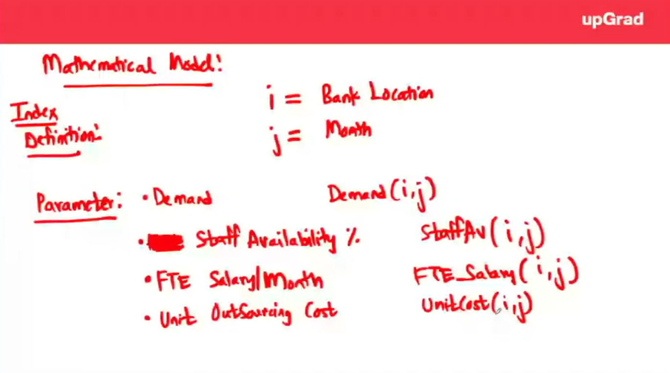

Slide 23
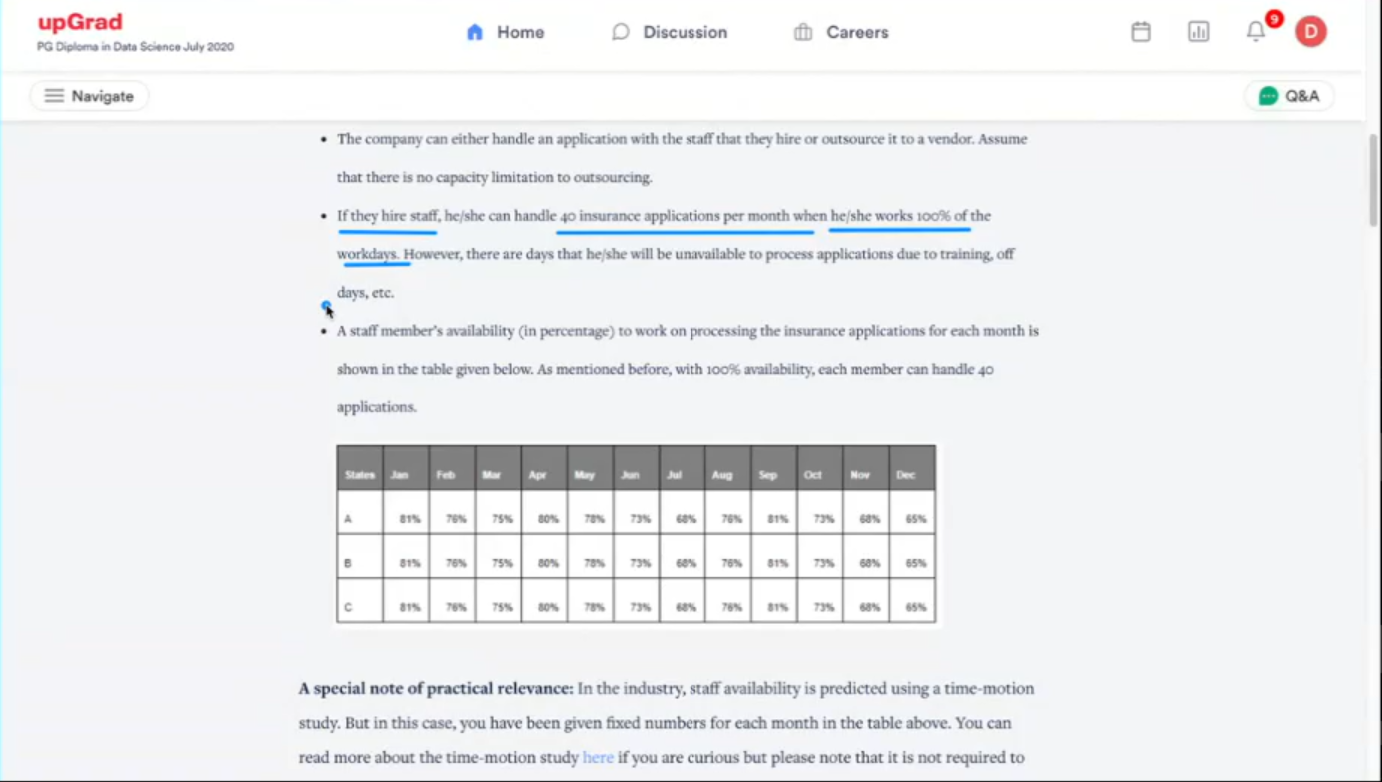
FTE Serving Rate

Slide 24
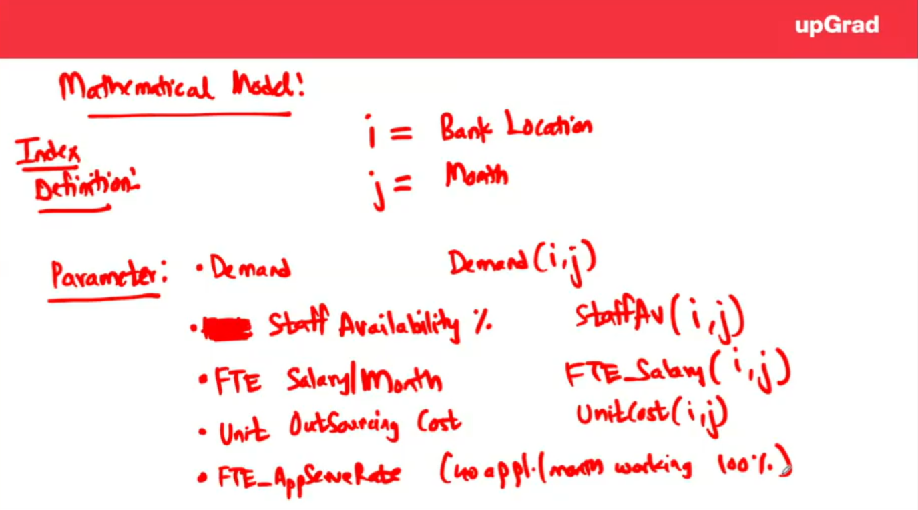

Slide 25
What is our Decision Variable ?
Our decision variable will be based on;
We have to distribute our application amongst Full Time Employees (FTE) and Outsourced vendors.
We have to distribute the cost of applications between FTE and Outsourced vendors
So, decision variable is mainly going to be these two. Cost is what we need to optimize Whenever, we talk about money that will go into objective function so in this case over here we are going to have the decision variables as my FTE and the outsourced vendors

Slide 26
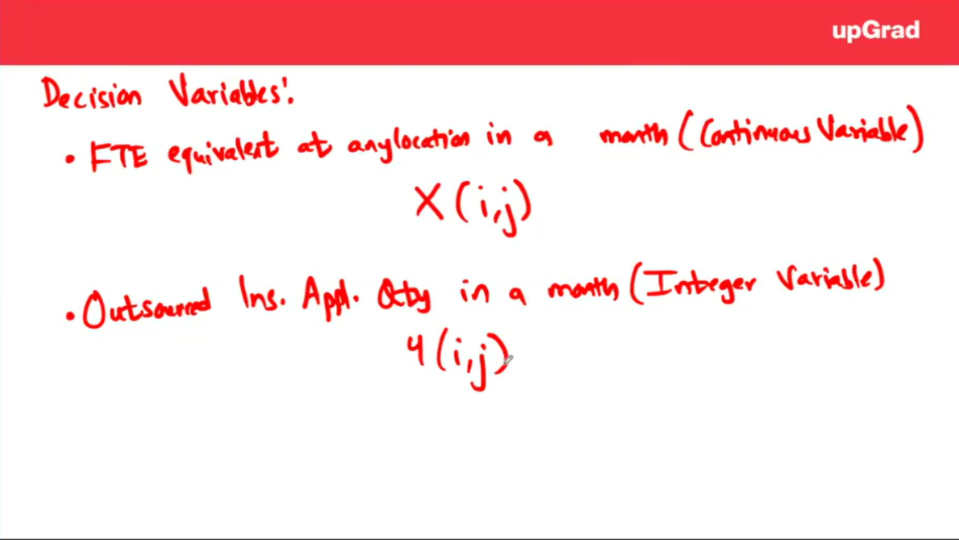

Slide 27
Underlying Objective
How much money we have to spend clearly depends on 2 things;
The total cost we have to spend on our Full Time Employees (FTE) added with the total cost which we have to spend on our outsourced employees. To remind we are looking at yearly budget for entire 2021
We have to minimize the annual cost
month-salary(i, j) * X(i, j) + Y(i, j) * cost_of_outsourcing(i, j)

Slide 28
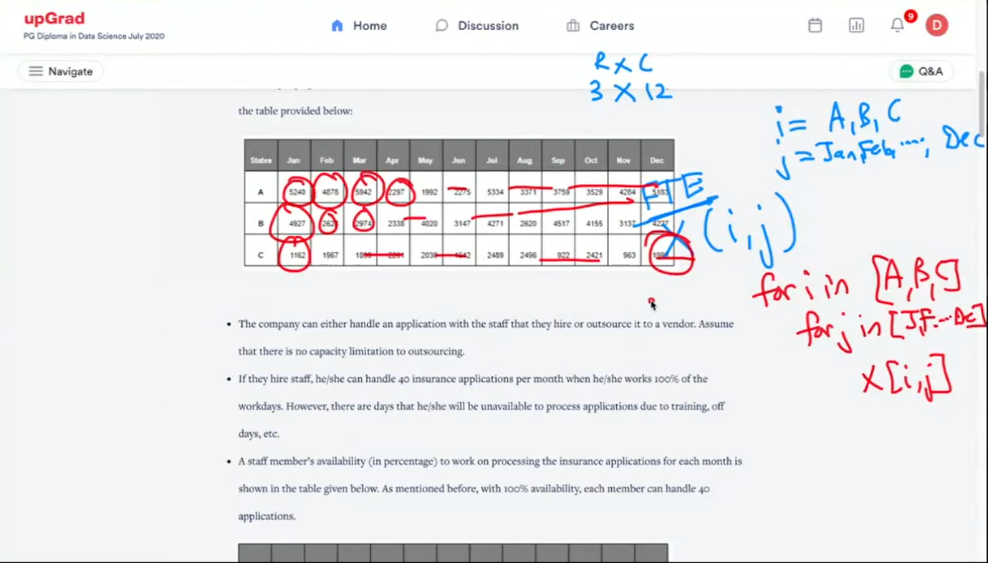

Slide 29
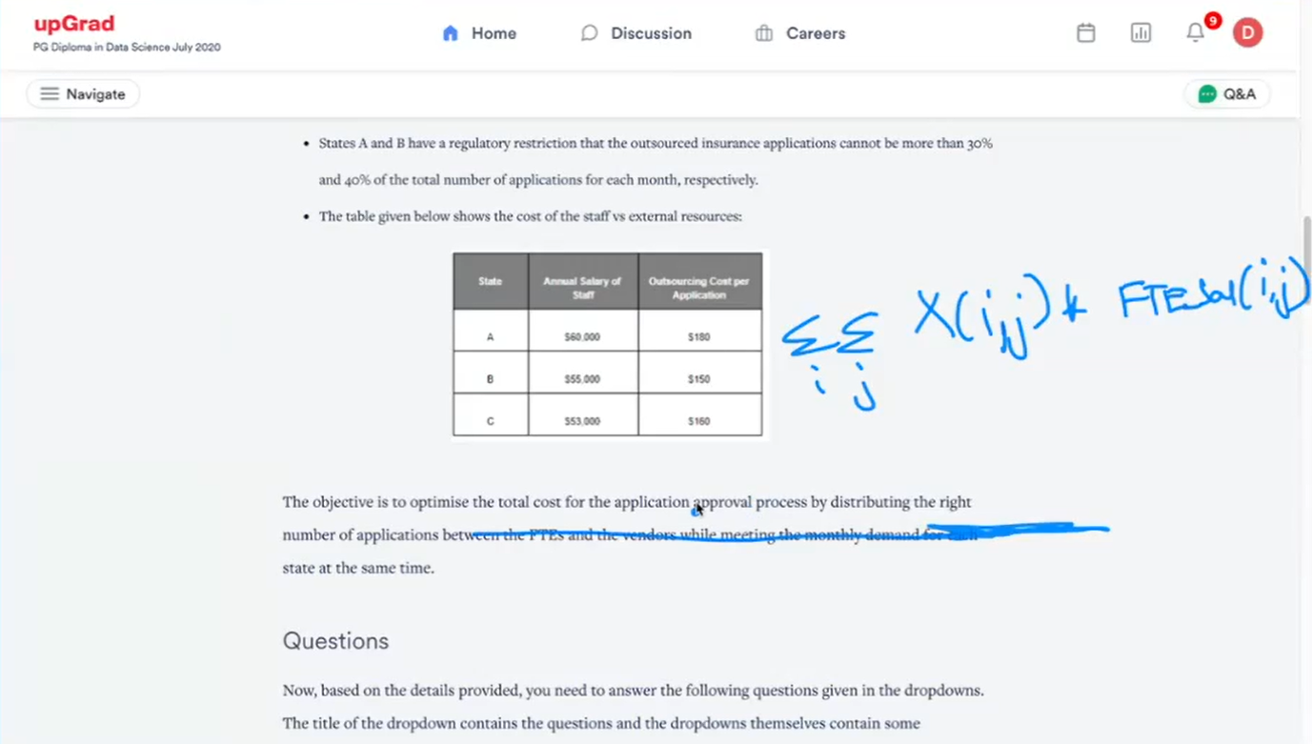

Slide 30
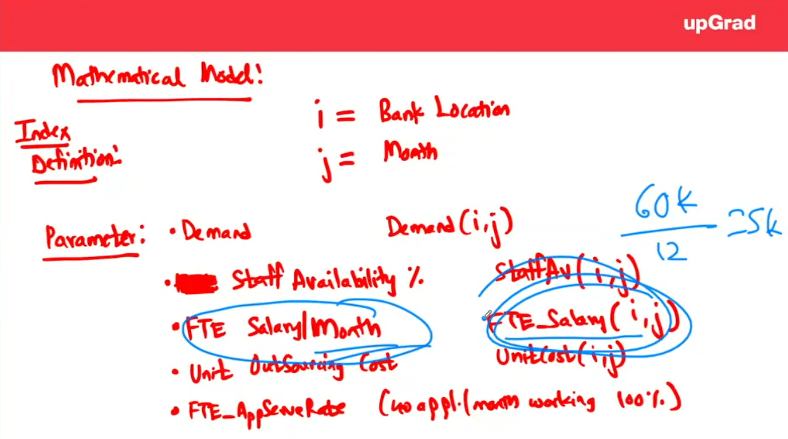

Slide 31
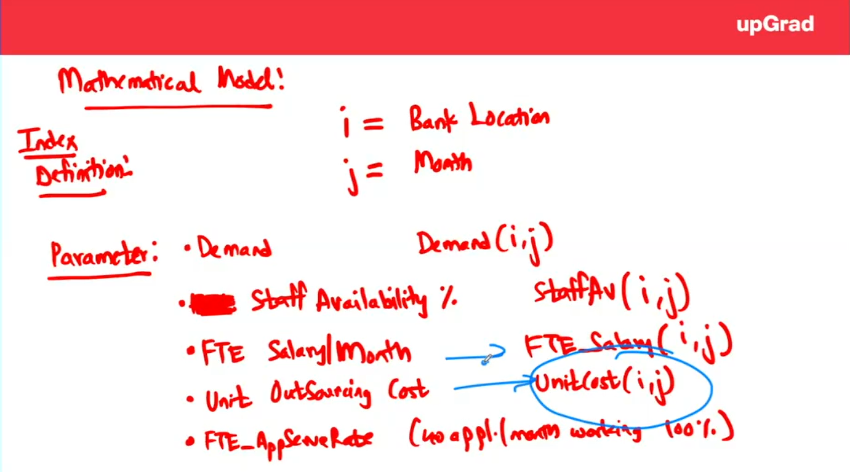

Slide 32
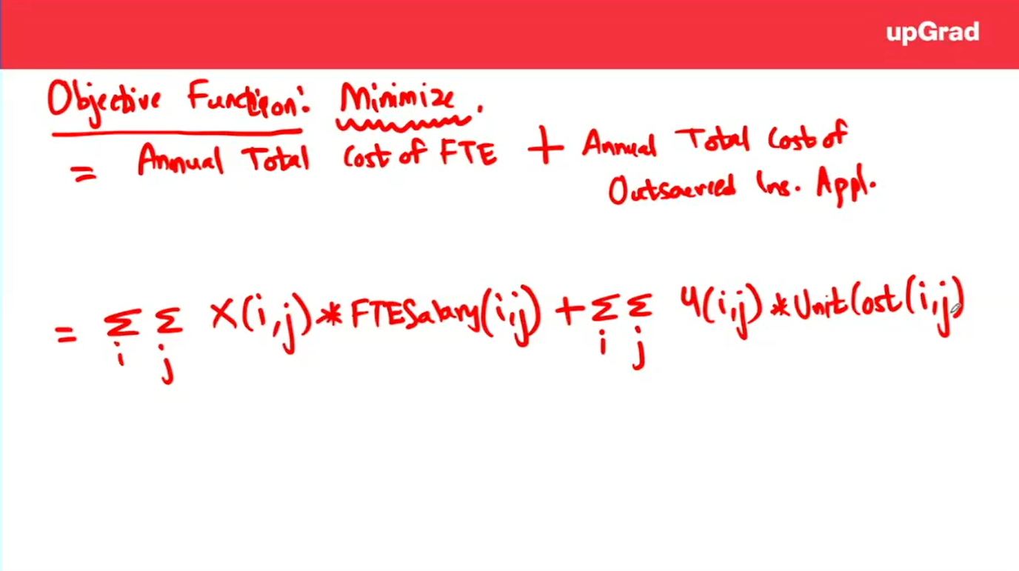

Slide 33
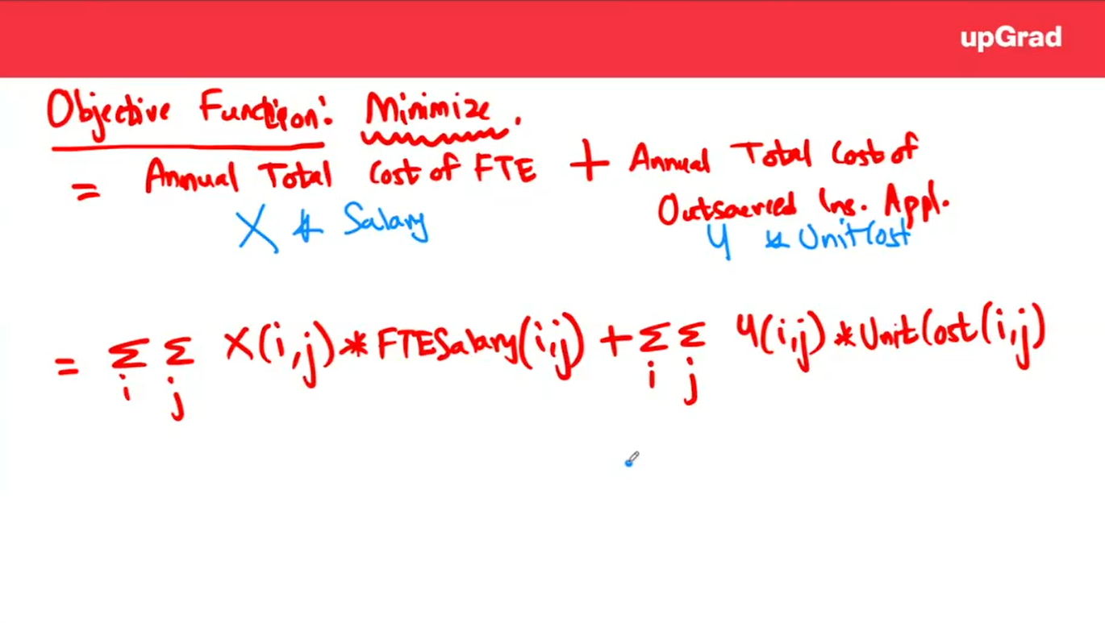
Annual cost of FTE (decision variable is X and what is given to us salary per month is given. X * Salary is going to the total cost
This is Y variable * Unitcost what is given to us

Slide 34
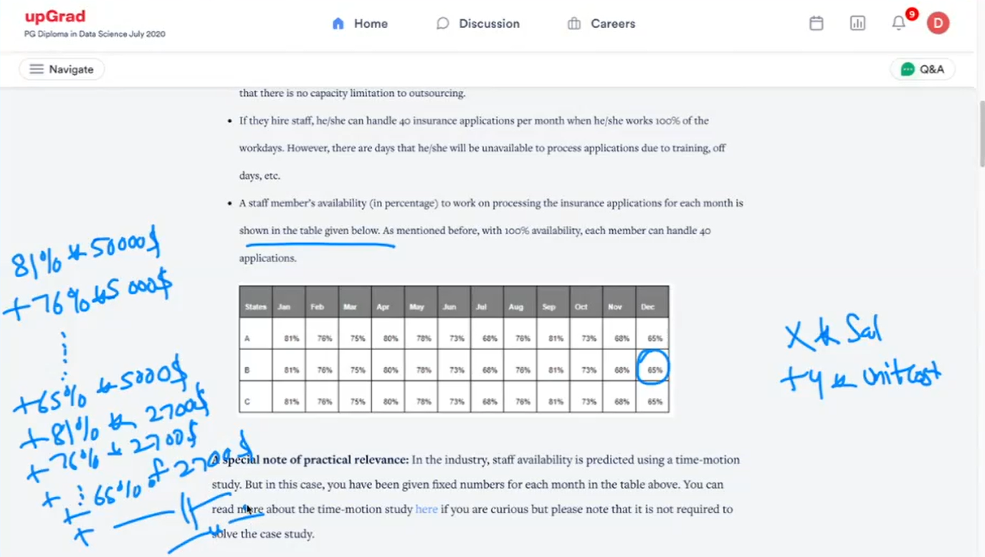
For Y variable we will be subtracting 81 from 100 to obtain it

Slide 35
Constraint no.1
We know that my that we have to ensure whatever that might be full time availability and my outsourced application we know whatever be the FTE availability and our outsourced vendor application that should suffice exactly our Demand. It should not be less than or greater than demand and it has to be for all the bank locations(i) and months (j)
So, in simple words we can say that my FTE_Equivalent per month multiplied by Availability (that is given) multiplied by 40 Applications per FTE added with Outsourced insurance Application quantity. It should be equal to Insurance Application Demand per Month
When I say X of i,j – FTE availability per month multiplied by Staff availabilityof i, j multiplied by 40 added with number of Applications [Y(i,j)] which are outsourced which should be equivalent to Demand of (i, j) and this is for all (i, j)
To be noted that Objective Function is only Cost and not Demand

Slide 36
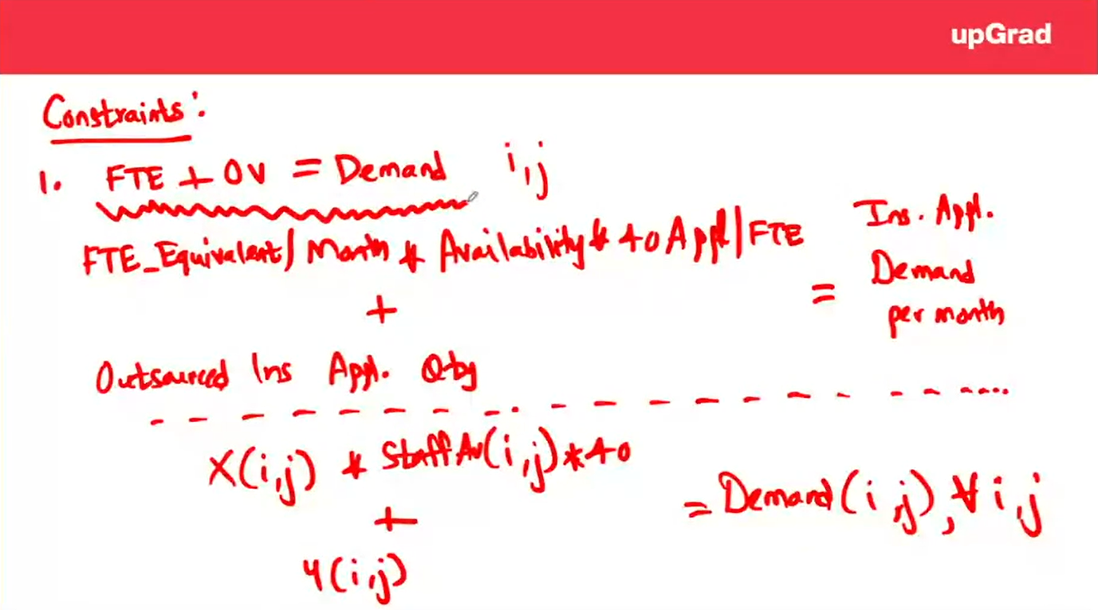
Wherever we are calculating over here constraints we are always writing
with respect to decision variable so if we donot have X & Y how can I write a demand,
can be equated only in terms of X & Y, individually they don’t have any importance
so we will not include Demand >=0

Slide 37
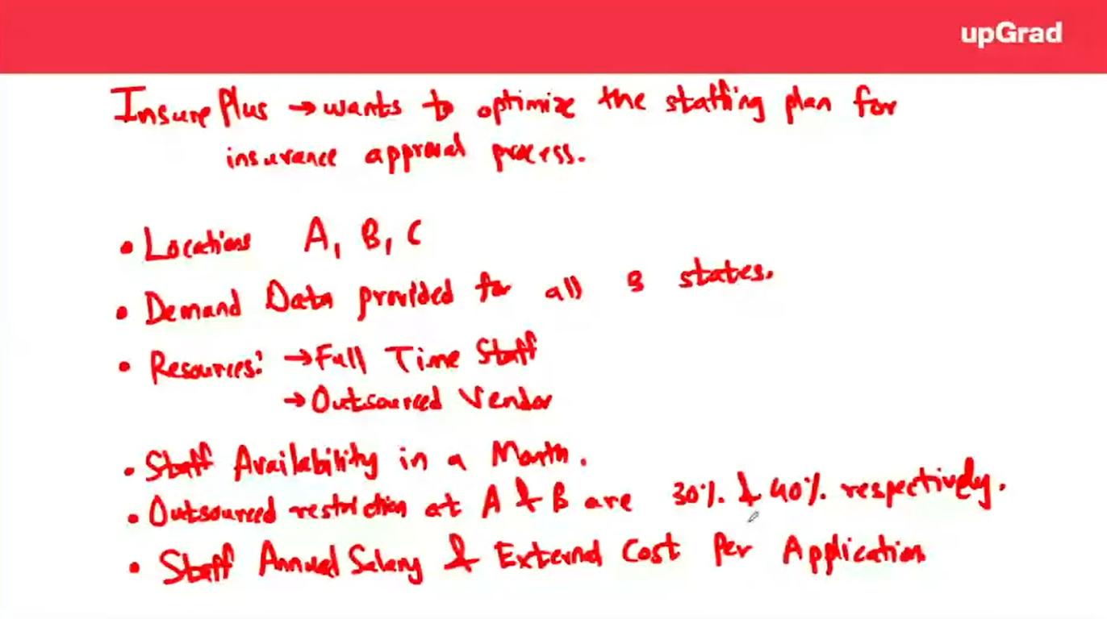
Constraint no. 2
Regulatory Constraint – A & B have a regulatory restriction that the outsourced application cannot be more than 30% & 40% of total number of applications respectively

Slide 38
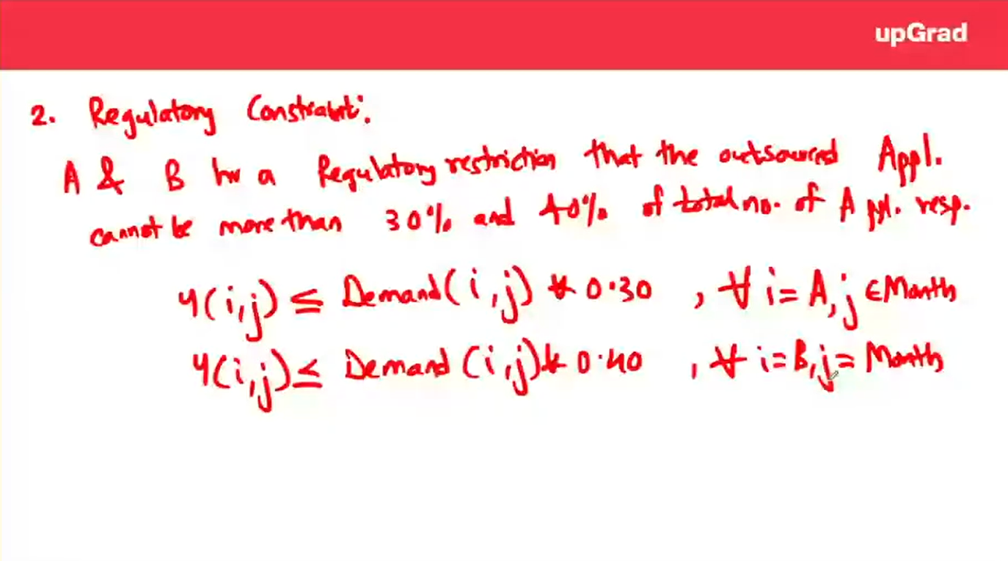
We don’t need demand >= 0 obviously because we are not
creating any variable for demand. Had we created a decision variable then
we can write that constant

Slide 39
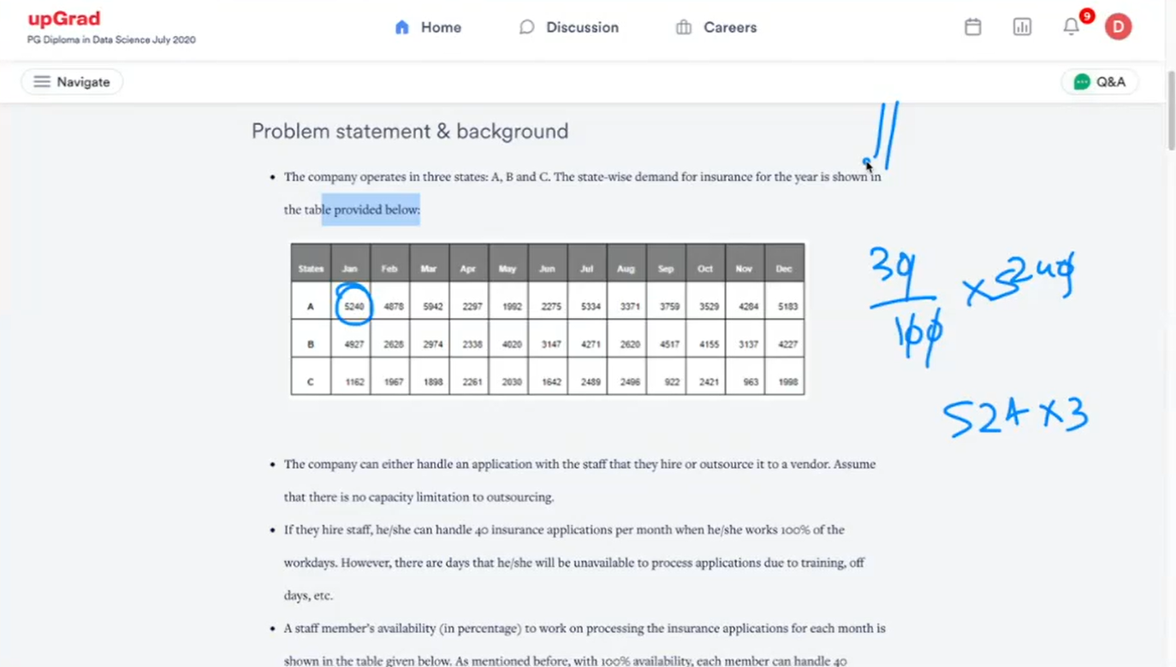

Slide 40
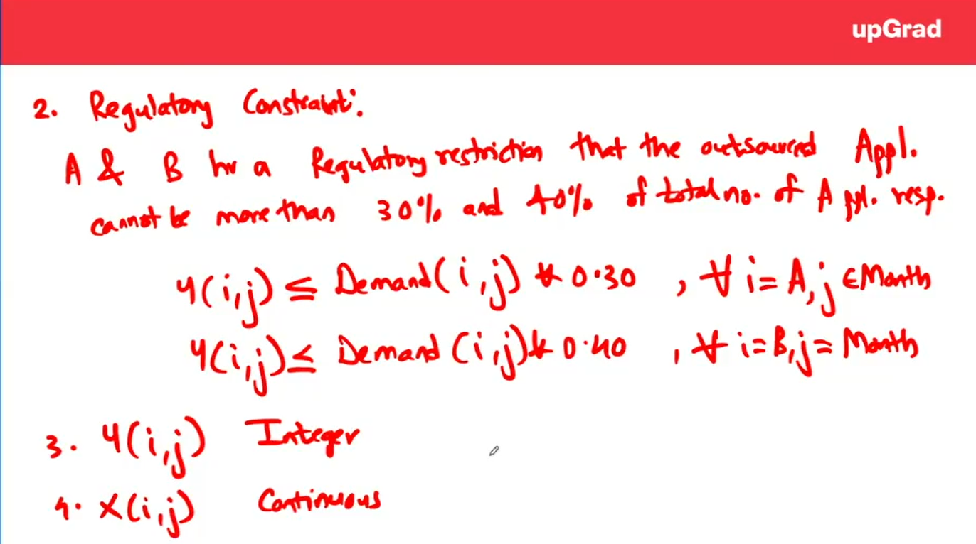
We don’t need demand >= 0 obviously because we are not
creating any variable for demand. Had we created a decision variable then
we can write that constant

Slide 41
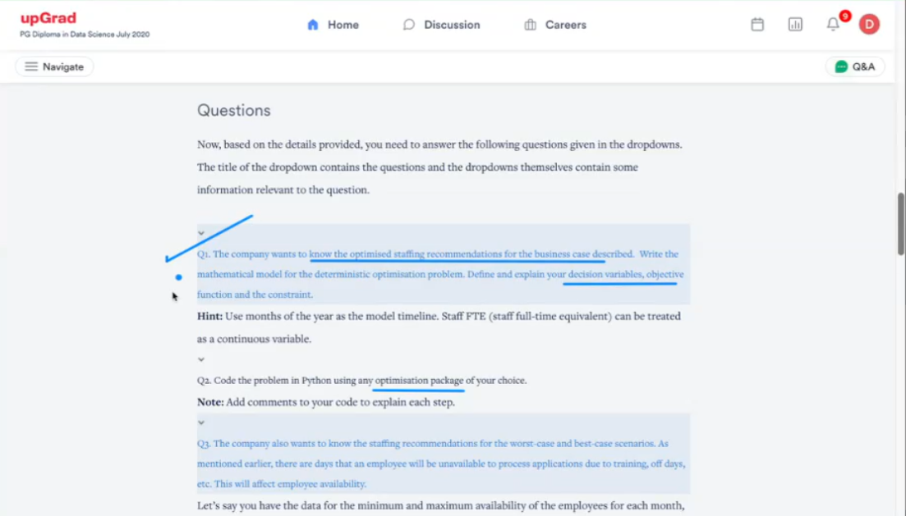

Slide 42
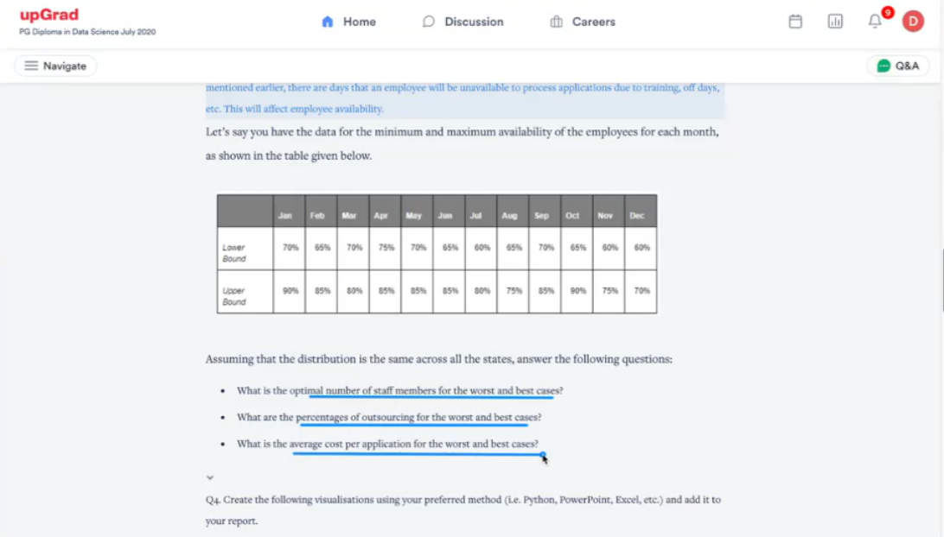

Slide 43
